Slide 1





Objects and Classes
Using Objects and Classes Defining Simple Classes
Programming Fundamentals
O
O
SoftUni Team
O
O
Technical Trainers
P
P
Software University
http://softuni.bg

Slide 2
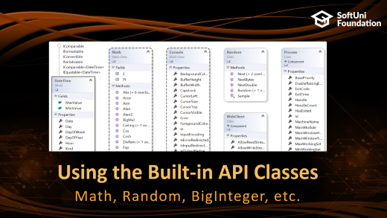
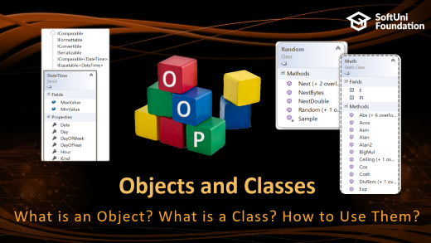
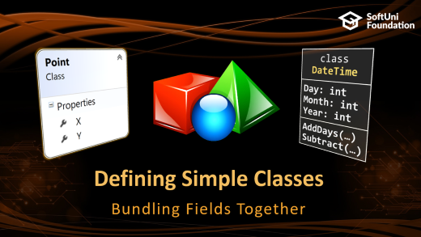
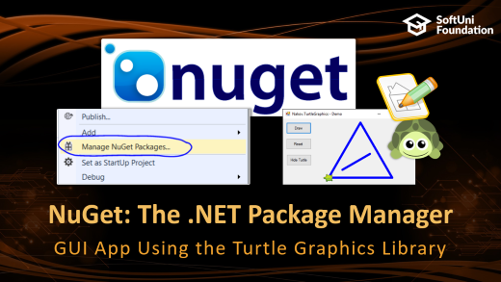
Table of Contents

Slide 3
Have a Question?
sli.do #fund-softuni

Slide 4
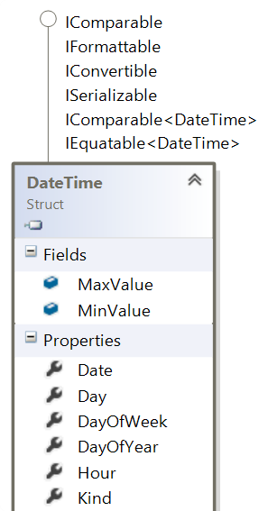
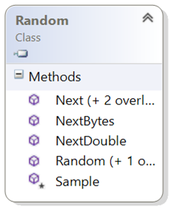
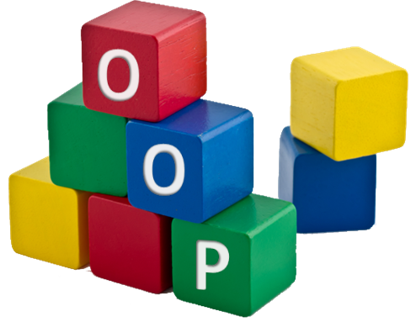
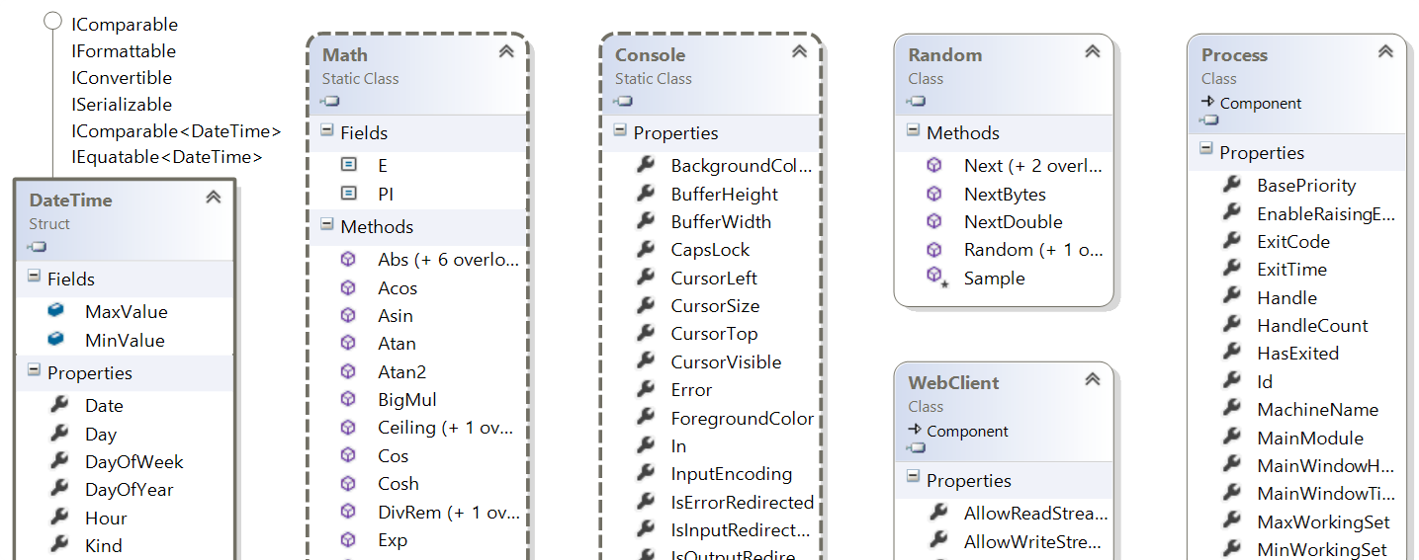
Objects and Classes
What is an Object? What is a Class? How to Use Them?

Slide 5
Objects
Create a new object of type DateTime
An object holds a set of named values
E.g. birthday object holds day, month and year
Creating a birthday object:
Object name
var day = new DateTime(
2017, 6, 19); Console.WriteLine(day);
Birthday
Day = 27
Month = 11
Year = 1996
Object properties
The new operator creates a new object
var birthday = new { Day = 27, Month = 11, Year = 1996 };

Slide 6
Classes
In programming, classes provide the structure for objects
Act as template for objects of the same type
Classes define:
Data (properties, attributes), e.g. Day, Month, Year
Actions (behavior), e.g. AddDays(count), Subtract(date)
One class may have many instances (objects)
Sample class: DateTime
Sample objects: peterBirthday, mariaBirthday

Slide 7
Classes vs. Objects
Objects
Classes
object peterBirthday
Object name
Class name
class DateTime
Day = 27
Month = 11
Year = 1996
Object data
Day: int
Month: int
Year: int
Class data (properties)
object mariaBirthday
Object name
AddDays(…)
Subtract(…)
Class actions (methods)
Day = 14
Month = 6
Year = 1995
Object data

Slide 8
Objects and Classes – Example
DateTime peterBirthday = new DateTime(1996, 11, 27);
DateTime mariaBirthday = new DateTime(1995, 6, 14);
Console.WriteLine("Peter's birth date: {0:d-MMM-yyyy}",
peterBirthday); // 27-Nov-1996
Console.WriteLine("Maria's birth date: {0:d-MMM-yyyy}",
mariaBirthday); // 14-Jun-1995
var mariaAfter18Months = mariaBirthday.AddMonths(18);
Console.WriteLine("Maria after 18 months: {0:d-MMM-yyyy}",
mariaAfter18Months); // 14-Dec-1996
TimeSpan ageDiff = peterBirthday.Subtract(mariaBirthday);
Console.WriteLine("Maria older than Peter by: {0} days",
ageDiff.Days); // 532 days

Slide 9
Problem: Day of Week
You are given a date in format day-month-year
Calculate and print the day of week in English
18-04-2016
Monday
27-11-1996
Wednesday
string dateAsText = Console.ReadLine();
DateTime date = DateTime.ParseExact(
dateAsText, "d-M-yyyy",
CultureInfo.InvariantCulture);
Console.WriteLine(date.DayOfWeek);
ParseExact(…) needs a format string + culture (locale)
Check your solution here: https://judge.softuni.bg/Contests/Practice/Index/175#0

Slide 10
Using the Built-in API Classes
Math, Random, BigInteger, etc.

Slide 11
Built-in API Classes in .NET Framework
.NET Framework provides thousands of ready-to-use classes
Packaged into namespaces like System, System.Text, System.Collections, System.Linq, System.Net, etc.
Using static .NET class members:
Using non-static .NET classes
Class.StaticMember
DateTime today = DateTime.Now;
double cosine = Math.Cos(Math.PI);
new Class(…)
Random rnd = new Random();
int randomNumber = rnd.Next(1, 99);
Object.Member

Slide 12
Built-in .NET Classes – Examples
DateTime today = DateTime.Now;
Console.WriteLine("Today is: " + today);
DateTime tomorrow = today.AddDays(1);
Console.WriteLine("Tomorrow is: " + tomorrow);
double angleDegrees = 60;
double angleRadians = angleDegrees * Math.PI / 180;
Console.WriteLine(Math.Cos(angleRadians)); // 0.5
Random rnd = new Random();
Console.WriteLine("Random number = " + rnd.Next(1, 100));
WebClient webClient = new WebClient();
webClient.DownloadFile("http://www.introprogramming.info/wp-content/uploads/2015/10/Intro-CSharp-Book-v2015.pdf", "book.pdf");
Process.Start("book.pdf");

Slide 13
Problem: Randomize Words
You are given a list of words
Randomize their order and print each word at a separate line
a b
PHP Java C#
10S 7H 9C 9D JS
b
a
Java
PHP
C#
7H
JS
10S
9C
9D
Note: the output is a sample. It should always be different!
Check your solution here: https://judge.softuni.bg/Contests/Practice/Index/175#1

Slide 14
Solution: Randomize Words
string[] words = Console.ReadLine().Split(' ');
Random rnd = new Random();
for (int pos1 = 0; pos1 < words.Length; pos1++)
{
int pos2 = rnd.Next(words.Length);
// TODO: swap words[pos1] with words[pos2]
}
Console.WriteLine(string.Join
("Environment.NewLine", words));
Check your solution here: https://judge.softuni.bg/Contests/Practice/Index/175#1

Slide 15
Problem: Big Factorial
Calculate n! (n factorial) for very big n (e.g. 1000)
5
120
10
3628800
12
479001600
30414093201713378043612608166064768844377641568960512000000000000
50
185482642257398439114796845645546284380220968949399346684421580986889562184028199319100141244804501828416633516851200000000000000000000
88
Check your solution here: https://judge.softuni.bg/Contests/Practice/Index/175#2

Slide 16
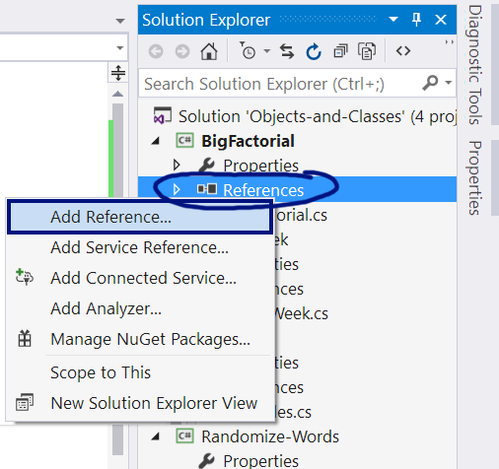
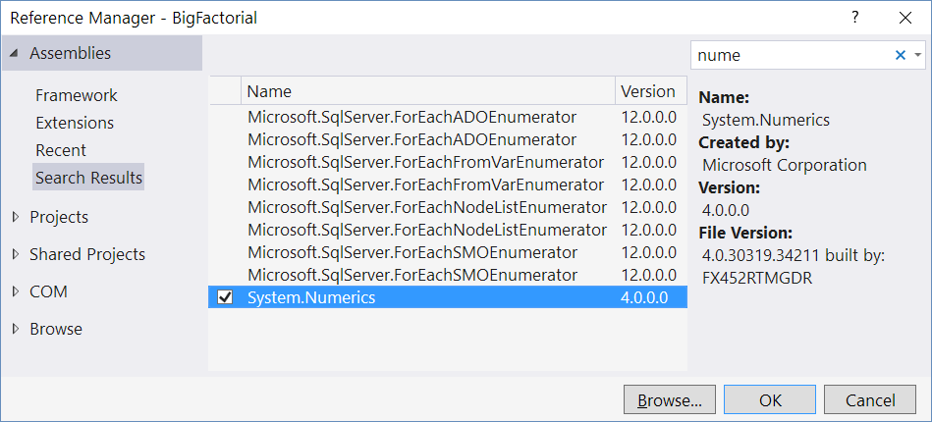
Solution: Big Factorial
int n = int.Parse(Console.ReadLine());
BigInteger f = 1;
for (int i = 2; i <= n; i++) f *= i;
Console.WriteLine(f);
Use the .NET API class System.Numerics .BigInteger
Check your solution here: https://judge.softuni.bg/Contests/Practice/Index/175#2

Slide 17

Using the Built-in .NET Classes
Live Exercises in Class (Lab)

Slide 18


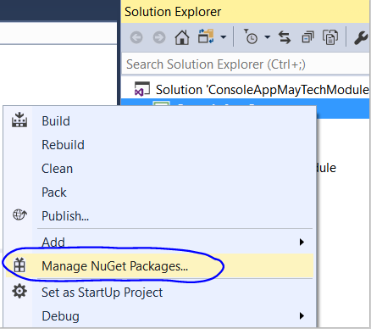
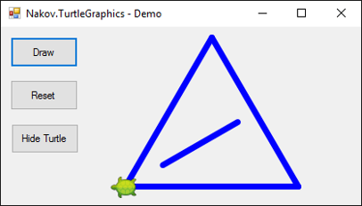

NuGet: The .NET Package Manager
GUI App Using the Turtle Graphics Library

Slide 19
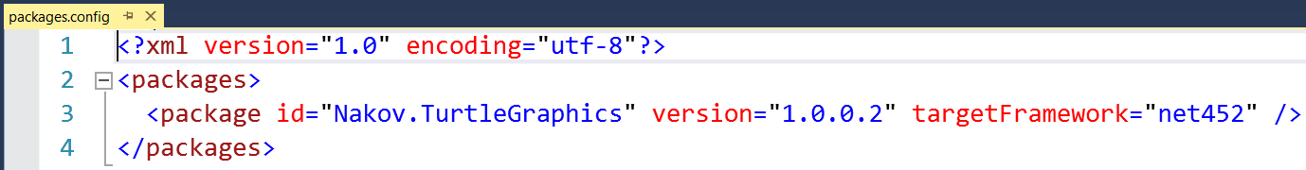
What is NuGet?
NuGet is a package manager for the .NET platform
Holds thousands of .NET libraries
Find a package (library) and install it
https://www.nuget.org
Project dependencies (external libraries) are described in package.config file

Slide 20
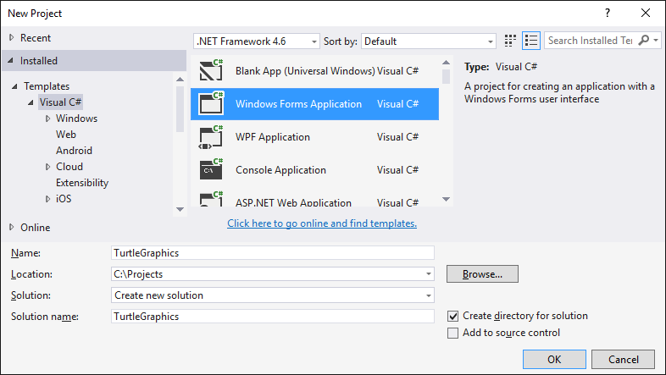
Create a New Windows Forms Project

Slide 21
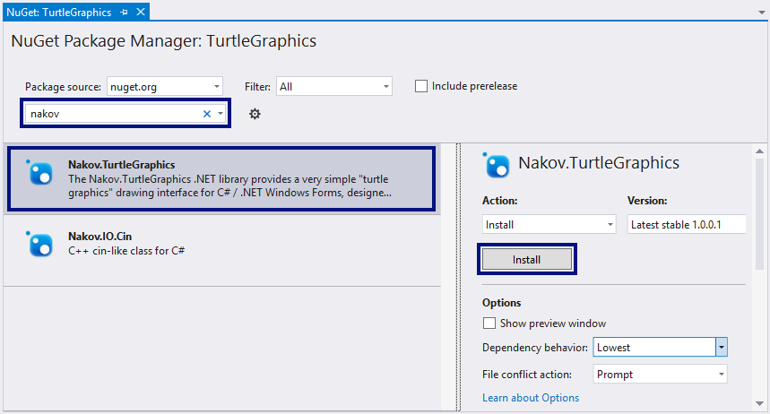
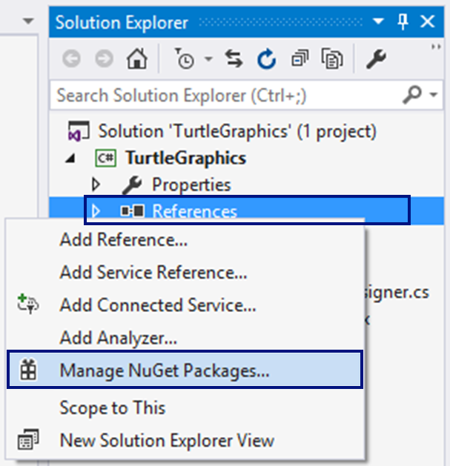
Install the NuGet Package "Nakov.TurtleGraphics"

Slide 22
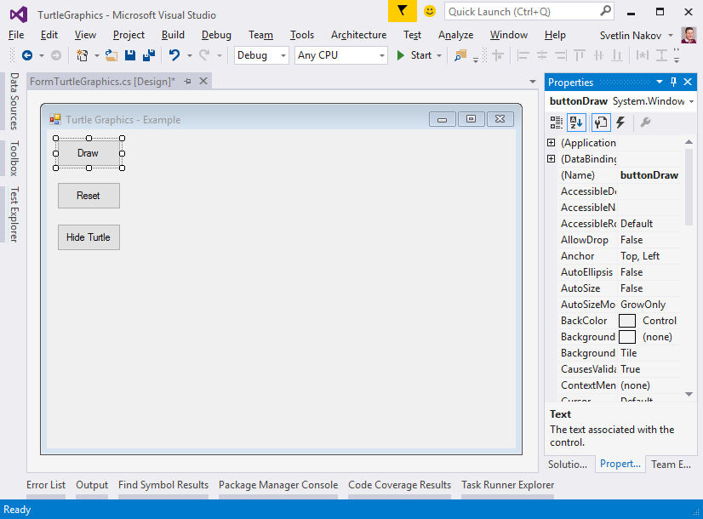
Design Turtle Graphics App
private void buttonDraw_Click(
object sender,
EventArgs e)
{
Turtle.Rotate(30);
Turtle.Forward(200);
Turtle.Rotate(120);
Turtle.Forward(200);
Turtle.Rotate(120);
Turtle.Forward(200);
…
}
FormTurtleGraphics
Text = "Turtle Graphics - Example"
buttonDraw
Text = "Draw"
buttonReset
Text = "Reset"
buttonShowHideTurtle
Text = "Hide Turtle"

Slide 23
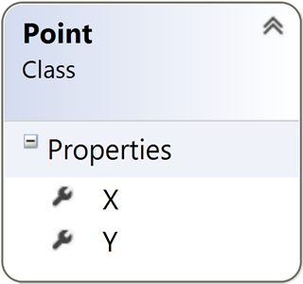
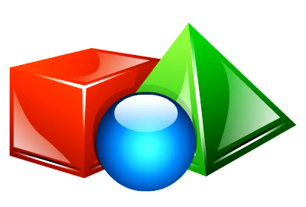
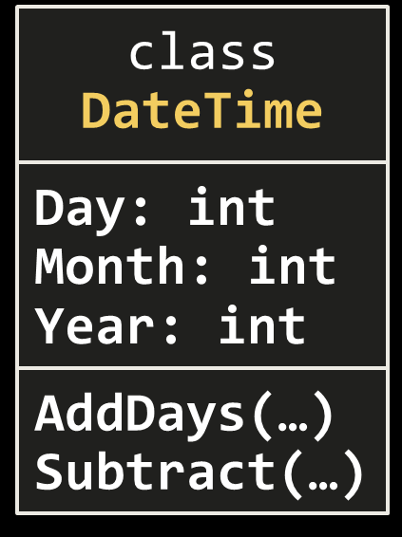
Defining Simple Classes
Bundling Fields Together

Slide 24
Defining Simple Classes
Simple classes hold a few fields of data, e.g.
Class name
Class properties (hold class data)
class Point
{
public int X { get; set; }
public int Y { get; set; }
}
Point p = new Point() { X = 5, Y = 7 };
Console.WriteLine("Point({0}, {1})", p.X, p.Y);
Creating а new object p of class Point

Slide 25
Problem: Distance between Points
Write a method to calculate the distance between two points p₁ {x₁, y₁} and p₂ {x₂, y₂}
Write a program to read two points (given as two integers) and print the Euclidean distance between them
double CalcDistance(Point p1, Point p2)
{ … }
3 4
6 8
5.000
3 4
5 4
2.000
8 -2
-1 5
11.402
Check your solution here: https://judge.softuni.bg/Contests/Practice/Index/175#3

Slide 26
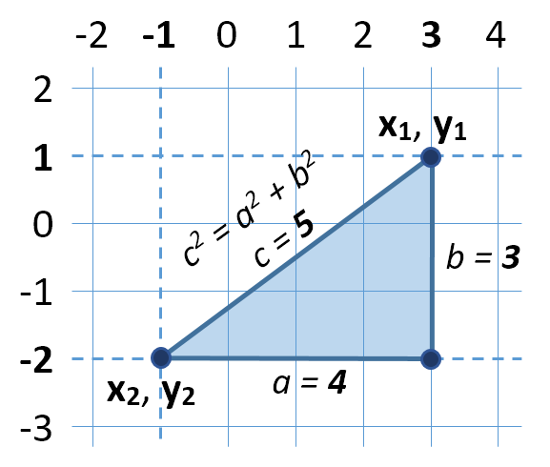

Solution: Distance between Points
Let's have two points p₁ {x₁, y₁} and p₂ {x₂, y₂}
Draw a right-angled triangle
Side a = |x₁ - x₂|
Side b = |y₁ - y₂|
Distance == side c (hypotenuse)
c² = a² + b² (Pythagorean theorem)
Distance = c = $\sqrt{a^{2}+b^{2}}$

Slide 27
Solution: Distance between Points
static void Main()
{
// Reads both points separately
Point p1 = ReadPoint();
Point p2 = ReadPoint();
// Calculate the distance between them
double distance = CalcDistance(p1, p2);
// Print the distance
Console.WriteLine("Distance: {0:f3}", distance);
}
Check your solution here: https://judge.softuni.bg/Contests/Practice/Index/175#3

Slide 28
Solution: Distance between Points(2)
static Point ReadPoint()
{
int[] pointInfo = Console.ReadLine().Split()
.Select(int.Parse).ToArray();
Point point = new Point();
point.X = pointInfo[0];
point.Y = pointInfo[1];
return point;
}
static double CalcDistance(Point p1, Point p2)
{
int deltaX = p2.X - p1.X;
int deltaY = p2.Y - p1.Y;
return Math.Sqrt(deltaX * deltaX + deltaY * deltaY);
}

Slide 29
Problem: Closest Two Points
Write a program to read n points and print the closest two of them
4
3 4
6 8
2 5
-1 3
4
-2 3
12 5
9 18
2 -6
3
12 -30
6 18
6 18
3
1 1
2 2
3 3
3
-4 18
8 -7
12 -3
1.414
(3, 4)
(2, 5)
0.000
(6, 18)
(6, 18)
1.414
(1, 1)
(2, 2)
5.657
(8, -7)
(12, -3)
9.849
(-2, 3)
(2, -6)
Check your solution here: https://judge.softuni.bg/Contests/Practice/Index/175#4

Slide 30
Solution: Closest Two Points
static void Main()
{
Point[] points = ReadPoints();
Point[] closestPoints = FindClosestTwoPoints(points);
PrintDistance(closestPoints);
PrintPoint(closestPoints[0]);
PrintPoint(closestPoints[1]);
}
Check your solution here: https://judge.softuni.bg/Contests/Practice/Index/175#4

Slide 31
Solution: Closest Two Points (2)
static Point[] ReadPoints()
{
int n = int.Parse(Console.ReadLine());
Point[] points = new Point[n];
for (int i = 0; i < n; i++)
{
points[i] = ReadPoint();
}
return points;
}
Check your solution here: https://judge.softuni.bg/Contests/Practice/Index/175#4

Slide 32
Solution: Closest Two Points (3)
static void PrintPoint(Point point)
{
Console.WriteLine("({0}, {1})", point.X, point.Y);
}
static void PrintDistance(Point[] points)
{
double distance = CalcDistance(points[0], points[1]);
Console.WriteLine("{0:f3}", distance):
}
Check your solution here: https://judge.softuni.bg/Contests/Practice/Index/175#4

Slide 33
Solution: Closest Two Points (4)
static Point[] FindClosestTwoPoints(Point[] points)
{
double minDistance = double.MaxValue;
Point[] closestTwoPoints = null;
for (int p1 = 0; p1 < points.Length; p1++)
for (int p2 = p1 + 1; p2 < points.Length; p2++)
{
double distance = CalcDistance(points[p1], points[p2]);
if (distance < minDistance)
{
minDistance = distance;
closestTwoPoints = new Point[] { points[p1], points[p2] };
}
}
return closestTwoPoints;
}

Slide 34
Class Operations
Classes can define data (state) and operations (actions)
class Rectangle
{
public int Top { get; set; }
public int Left { get; set; }
public int Width { get; set; }
public int Height { get; set; }
int CalcArea()
{
return Width * Height;
}
Classes may hold data (properties)
Classes may hold operations (methods)

Slide 35
Class Operations (2)
public int Bottom
{
get
{
return Top + Height;
}
}
public int Right
{
get
{
return Left + Width;
}
}
Calculated property
Calculated property
Boolean method
public bool IsInside(Rectangle r)
{
return (r.Left <= Left) && (r.Right >= Right) &&
(r.Top <= Top) && (r.Bottom >= Bottom);
}

Slide 36
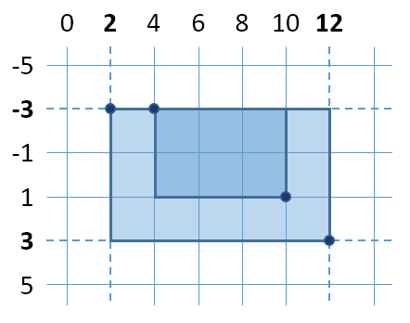
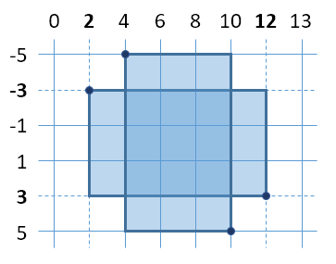
Problem: Rectangle Position
Write program to read two rectangles {left, top, width, height} and print whether the first is inside the second
4 -3 6 4
2 -3 10 6
2 -3 10 6
4 -5 6 10
Inside
Not inside
Rectangle r1 = ReadRectangle(), r2 = ReadRectangle();
Console.WriteLine(r1.IsInside(r2) ? "Inside" :
"Not inside");
Check your solution here: https://judge.softuni.bg/Contests/Practice/Index/175#5

Slide 37
Solution: Rectangle Position
public class Rectangle
{
public int Top { get; set; }
public int Left { get; set; }
public int Width { get; set; }
public int Height { get; set; }
public int Right { get { return Left + Width; } }
public int Bottom { get { return Top + Height; } }
// continued on next slide...
Class fields
Class properties

Slide 38
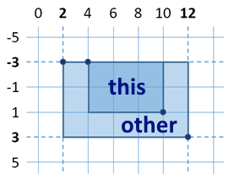
Solution: Rectangle Position (2)
public bool IsInside(Rectangle other)
{
var isInLeft = Left >= other.Left;
var isInRight = Right <= other.Right;
var isInsideHorizontal = isInLeft && isInRight;
var isInTop = Top >= other.Top;
var isInBottom = Bottom <= other.Bottom;
var isInsideVertical = isInTop && isInBottom;
return isInsideHorizontal && isInsideVertical;
}

Slide 39
Solution: Rectangle Position (3)
public static Rectangle ReadRectangle()
{
var size = Console.ReadLine().Split().Select(int.Parse);
Rectangle rectangle = new Rectangle()
{
Left = sizes.First(),
Top = sizes.Skip(1).First(),
Width = sizes.Skip(2).First(),
Height = sizes.Skip(3).First()
};
return rectangle;
}

Slide 40
Problem: Sales Report
Write a class Sale holding the following data:
Town, product, price, quantity
Read a list of sales and print the total sales by town:
5
Sofia beer 1.20 160
Varna chocolate 2.35 86
Sofia coffee 0.40 853
Varna apple 0.86 75.44
Plovdiv beer 1.10 88
Order the results by town name
Plovdiv -> 96.80
Sofia -> 533.20
Varna -> 266.98
Check your solution here: https://judge.softuni.bg/Contests/Practice/Index/175#6

Slide 41
Solution: Sales Report
class Sale
{
public string Town { get; set; }
// TODO: add the other fields …
public decimal Quantity { get; set; }
}
static Sale ReadSale()
{
string[] items = Console.ReadLine().Split();
return new Sale() {
Town = items[0], …, Quantity = decimal.Parse(items[3])
};
}

Slide 42
Solution: Sales Report (2)
static Sale[] ReadSales()
{
int n = int.Parse(Console.ReadLine());
Sale[] sales = new Sale[n];
// TODO: read the sales …
}
…
Sale[] sales = ReadSales();
var towns = sales.Select(s => s.Town).Distinct().OrderBy(t => t);
foreach (string town in towns)
{
var salesByTown = sales.Where(s => s.Town == town)
.Select(s => s.Price * s.Quantity);
Console.WriteLine("{0} -> {1:f2}", town, salesByTown.Sum());
}
Can you make this faster using SortedDictionary
<string, decimal>?

Slide 43
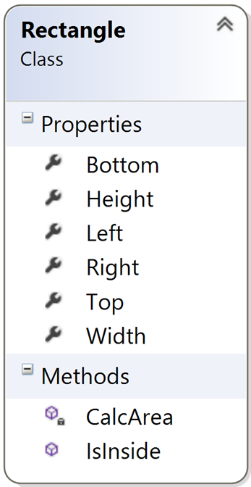
Defining Simple Classes
Live Exercises in Class (Lab)

Slide 44

Summary
Objects holds a set of named values
Classes define templates for object (data + actions)
Creating and using objects:
Defining and using classes:
DateTime d = new DateTime(1980, 6, 14);
Console.WriteLine(d.Year);
class Point {
public int X { get; set; }
public int Y { get; set; }
}
Point p1 = new Point() { X = 5, Y = -2 };
Point p2 = new Point() { X = -8, Y = 11 };

Slide 45








Programming Fundamentals – Objects & Classes
https://softuni.bg/courses/programming-fundamentals

Slide 46
License
This course (slides, examples, demos, videos, homework, etc.) is licensed under the "Creative Commons Attribution-NonCommercial-ShareAlike 4.0 International" license

Slide 47





Trainings @ Software University (SoftUni)
Software University – High-Quality Education, Profession and Job for Software Developers
softuni.bg
Software University Foundation
http://softuni.foundation/
Software University @ Facebook
facebook.com/SoftwareUniversity
Software University Forums
forum.softuni.bg

